Slide 1
Barriers of entry to Africa

Slide 2
Africa - New World
Understanding
Immersing
Embracing
Breaking the stereotypes

Slide 3
Regulation & cultural context
Level of regulatory framework
Structure & people behind the scene
Readiness to evolve & gain knowledge
…..

Slide 4
People & Local Culture
Building trust while combating fraud
Constant Search for Talent
Evolution of gambling: Story of Technical Background
Who runs the show: Local or expat?
Notes:
Title

Slide 5
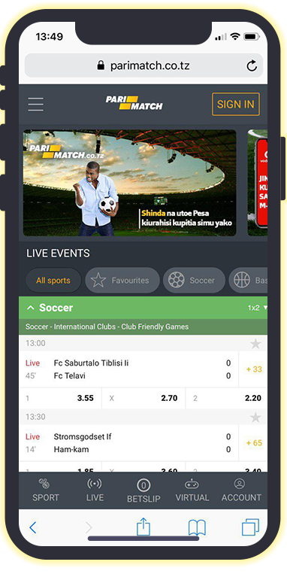
Product
Technology level of the state
Telecom & Communications coverage
Payment solutions: mobile money, e-wallets, & banks
UI & CX
expectations
Notes:
Title

